Slide 1
National Issues and Context Restraints
The asylum process.
Detention, Deportation, Destitution and Dispersal.

Slide 2
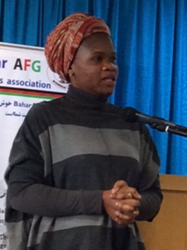
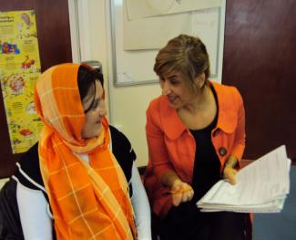
Asylum issues affecting women
Accommodation
Fear of 4 D’s dispersal, destitution, detention and deportation
Living in Limbo
Lack of knowledge of support
12% maternity deaths to AS&R women though 0.32% population (Lewis 2007)
Notes:
Hard to focus on giving birth if worried whether you will have a roof over you head. Fortunetely, family support workers from the Children’s Centre attend and offer individuals support. Domestic violence – midwives now work hard to get women to disclose if they experience violence but we have found if a women has no access to funding or benefits, then she is not entitled to access a safe house. We have to sympathises and send her back and she is told to avoid confrontation as much as she can. Amnesity have a campaign against this situation

Slide 3
Detention: Medical Justice, Expecting Change Report
Home Office policy outlines that:
‘Pregnant women should not normally be detained. The exceptions to this general rule are where removal is imminent and medical advice does not suggest confinement before the due removal date.’
The results show that women do not always receive NHS equivalent care in detention and the factors that could put them and their babies at risk are not always identified. Information given to detained women about antenatal care is limited; informed consent is rare; mental illnesses are not detected or treated effectively; high risk pregnancies are not always identified; and inappropriate malaria prophylaxis is regularly prescribed.
The overwhelming majority of women who are detained are not removed but released back into the community later in their pregnancy: 95% of our sample were not removed. With detention not resulting in removal, pregnant women are subject to interrupted care

Slide 4
Ex-Detainee:
I don’t want to remember those horrible moments of my life which I spent in detention, when I cried for food and cried due to pain. I was in a detention centre for seven months. I had severe morning sickness which lasted five months. I couldn’t eat the food which was provided for detainees. I remained there living just on fruit, juices, biscuits, crisps and popcorn for five months. I got weaker day by day.
I lost 6kg of my actual weight – it should increase in pregnancy. The doctors and nurses there shouted at me many times. They mentally tortured me by saying that I was on hunger strike. I was never on hunger strike: I love my baby so why would I go on hunger strike? I requested and begged the officers many times to allow me to go to eat something in the cultural kitchen because I always felt hungry – but they refused.
detainees get a daily allowance of 71 pence
I face risks to my life in my country. That is why I cannot go back to my country. And this is the reason why I suffered this awful situation and faced hardship for seven months as a detainee.

Slide 5
Destitution
Refused asylum seekers have access to the NHS in Wales- this is not the case in England.
But, people who have refused asylum applications will normally not have housing or NASS support.
Also, people who have appeals on going are often on Section 4 support- this is a cashless system which means that people cannot access public transport and can only use their card in certain shops.
Refused asylum seekers can only get section 4 support if they are taking all reasonable attempts to leave the UK or are unable to leave because of a medical reasons ( amongst others).
A woman has to be in 34th week of pregnancy before they can get section 4 support on the basis of being unfit to travel unless there are complications.

Slide 6
Dispersal
The Home Office issued new guidance on the dispersal of pregnant women and new mothers which should reduce the number of dispersals and allow better co-ordination and support for women when they do take place.
“Given the potential for increased risks to the health of some women in these circumstances, caseworkers should try to avoid dispersing women away from the area in which they are living and receiving maternity care, and in which they can access social and family support. If dispersal is unavoidable, caseworker should take particular care when arranging accommodation for pregnant women and their children.”
This is a fantastic change, but, there may well be some complications in ensuring that this is followed as it is a substantial change.

Slide 7
Isolation and Fear
Language barriers.
Loss of friends and family.
Differences in expectations of care or treatment
Concerns about case, money and accommodation.
Fear of detention, deportation and destitution.
Reasons for seeking asylum – human trafficking, forced marriage, honour based violence, fgm, experiencing torture.

