Slide 1
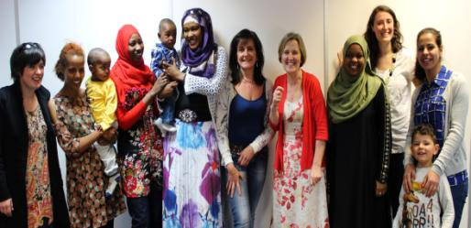
The Maternity Stream of Sanctuary
Notes:
Emily

Slide 2
Who is and what is City of Sanctuary?
City of Sanctuary is a national movement committed to building a culture of hospitality and welcome, especially for refugees seeking sanctuary from war and persecution.
The City of Sanctuary movement began in October 2005 in Sheffield. In September 2007, with the support of the City Council and over 70 local community organisations, Sheffield became the UK’s first ‘City of Sanctuary’ – a city that takes pride in the welcome it offers to people in need of safety.
There are now 51 Cities or areas of Sanctuary with 19 new and emerging groups across the UK- from Glasgow to Guernsey.
Crucially Asylum seekers and refugees at the heart of the movement. We work to include people seeking sanctuary at every level in the City of Sanctuary process - for example as volunteers and board members. We encourage our supporting organisations to do the same. We are guided by priorities defined by people seeking sanctuary
The movement aims to bring people together, raise awareness and celebrate the positive because when people meet each other, fears and myths dissolve and supportive relationships develop

Slide 3
City of Sanctuary is a movement committed to building a culture of hospitality and welcome, especially for refugees seeking sanctuary from war and persecution.
2005-Started in Sheffield
2011 – 12 groups
2014 - 38 groups
2015 - over 60 groups
2016 - ??

Slide 4
Swansea City of Sanctuary
Swansea became a dispersal area for asylum seekers in 2000 and since then many organisations developed to provide services and support for those seeking sanctuary.
Swansea City of Sanctuary Steering group was set up in June of 2008 and became the UK’s second official City of Sanctuary in May 2010.
The City and County of Swansea passed a unanimous resolution of support in 2008 and have been supportive ever since.

Slide 5
Asylum applications from main applicants increased by 19% to 29,024 in the year ending September 2015, the highest number of applications since the year ending June 2005 (30,314).
The largest number of applications for asylum came from nationals of Eritrea (3,726), followed by Sudan (2,842), Iran (2,407) and Syria (2,402).
Grant rates vary between nationalities; for example, at initial decision, the grant rate for nationals of Sudan was 84%, compared with 21% for Pakistani nationals.

Slide 6
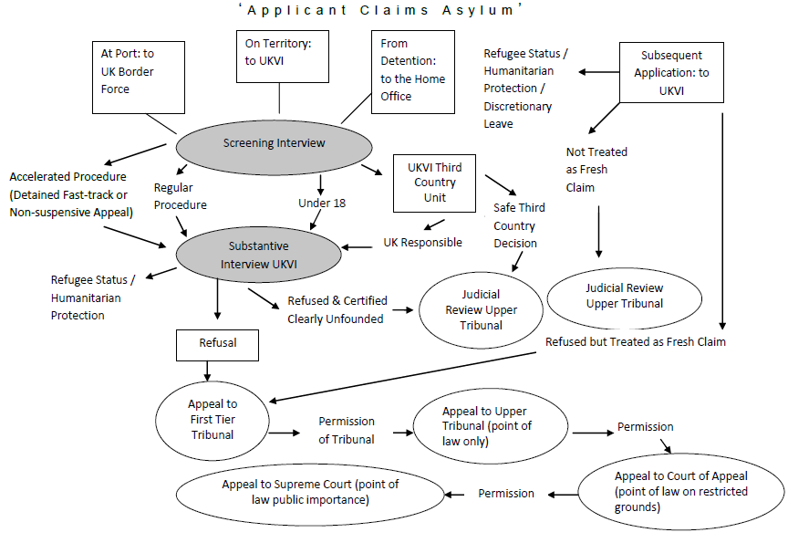
Why do we need cities of Sanctuary?
Families living at 50% below the poverty line
Insufficient benefits to maintain contact with solicitor
Shared, no choice accommodation, in hard to let properties managed by external contractors (Lynx House/ Red door)
Periods of destitution between refusal and appeal and on gaining refugee status or refusal with no chance of returning to country of origin
Detention at any time – indefinite, no judicial oversight
Possible deportation after many years building a family life ( including those that were unaccompanied asylum seeking children)

Slide 7
Narrative of the Process
A struggle
“Every time you go [to the home office], they show you how you can go back [home]....But I can’t. Because of safety. You see how safety is important for a human being. Even though I am struggling, I would like to go back. But I can’t go back. I prefer to struggle....But, in struggling, I am looking for ways to live well...you have in your mind, this struggle…this emotion of being mistreated” (Thomas)
Living with uncertainty
“You don’t feel safe, you don’t know how long you are able to stay for, you don’t know when your interview will be, you don’t know whether you will get granted or not. So the feeling of being unsafe gets worse…If you get a negative [asylum] result, what will happen? This makes you worry….you feel unsafe. After the [asylum]interview, you try to carry on with your life. ..try to get yourself more relaxed. But every day it gets worse, because all of the memories come back from back home …When you don’t have a positive decision, you always feel in a ‘storm’.”(Lila)
Speaking to others about decisions
“[Another] thing which hurt[s] me, are the other people [in my shared house who] talk about being refused, that I will be refused as well, they are all the time saying negative things, but I try not to speak with them that much” (Majid)
With kind permission from Tom Hoare

Slide 8
What can City of Sanctuary do?
We are an umbrella organisation
We work nationally across these themes:
Mainstream, grassroots movement – all sectors involved
Building bridges between ‘local people’ and refugees
Strengthening and broadening the support base for asylum seekers and refugees
Helping create a culture of hospitality and welcome
Celebrating the contribution of refugees to society
Creating and enhancing networks between key players
Arts
Destitution
Detention
ESOL
Faiths
Health
LGBT
Maternity
Schools
Sports
Syria
Welcome
Women

Slide 9
How do people support City of Sanctuary?
Pledging Process:
Getting involved
The first step in your support for City of Sanctuary is to pass a resolution of support and to send it to the City of Sanctuary Group.
While organisations are pledging, we ask people to think about actions that they can undertake. E.g. SCVS / Community Transport
Once an organisation is pledged we invite them to meetings, network events, training sessions..
Volunteering
Working groups
Challenging myths and spreading welcome
Supporting other organisations that work to welcome and support- Unity and Diversity, Swansea Bay Asylum Seeker Support Group ….

Slide 10
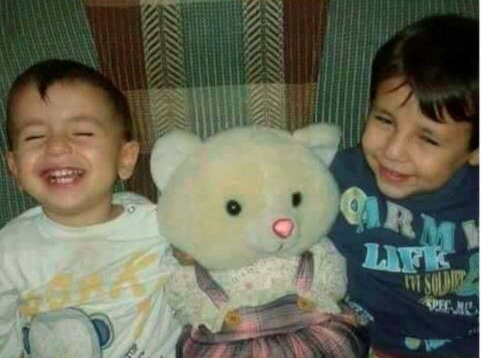
What has changed in last 12 months?
Refugee Crisis
Syrian Vulnerable Person Relocation Scheme.
Huge increase in support and interest
There were 40 Cities of Sanctuary at the end of the summer of 2015 but now there are 51 with 19 new and emerging groups.
Swansea Council pledged to welcome 20 Syrian families over the next 5 years.
Great news
But, it means that there is a two tier system for asylum now, which created new challenges.

Slide 11
Nation of Sanctuary
Refugee coalition
Sanctuary in the Senedd
We work together in the interests of asylum seekers and refugees, to ensure that our limited resources can be used to best effect and to speak with one voice on policies and practices affecting people seeking safety in Wales.
The Welsh Refugee Coalition supports the establishment of Wales as the world’s first ‘Nation of Sanctuary’. The Welsh Government can play its part in making this a reality by publicly supporting the movement, and by enacting policies and practices which promote safety and inclusion for all asylum seekers and refugees in Wales.
nation of sanctuary video
Over 120 people came to the Welsh Refugee Coalition’s event in the Senedd on 10th December, International Human Rights Day. A powerful partnership of refugees, friends, organisations and Assembly Members talked about how we can make Wales the World’s first Nation of Sanctuary.

Slide 12
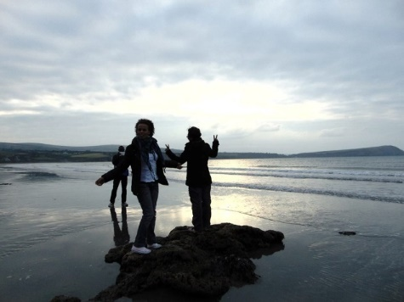
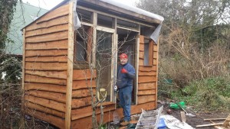
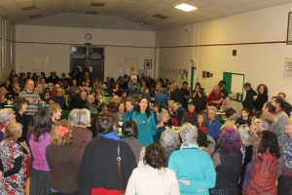
New Groups- Rural and non dispersal areas.
Hiraeth Hope is a West Wales based community group that is offering refugees and asylum seekers in Swansea, Cardiff and abroad a range of services and opportunities
Helping people have respite holidays, and the opportunities to meet others, get out of Swansea and share skills.

Slide 13
Welcome, support and celebrate the contribution that refugees and asylum seekers
There are many barriers faced by Refugees and Asylum seekers to gain employment, volunteering opportunities and access to further education.
Volunteering- DBS checks, reimbursement of travel costs, language barriers.
Oxfam book shop
Underemployment is a considerable issue for refugees
The Refugee Council/BMA Refugee Doctors Database Project has registered more than 920 unemployed refugee doctors in the UK (…) over 150 refugee nurses, the vast majority of them are unemployed (…) The Refugee Council/British Dental Association Refugee Dentists Voluntary Database has over 100 unemployed refugee dentists currently living in the UK.
There is a lot of confusion around entitlements to work, difficulties for people getting UK based references and language barriers.
The costs of getting qualifications recognised and accessing University is often costly and complex.

Slide 14
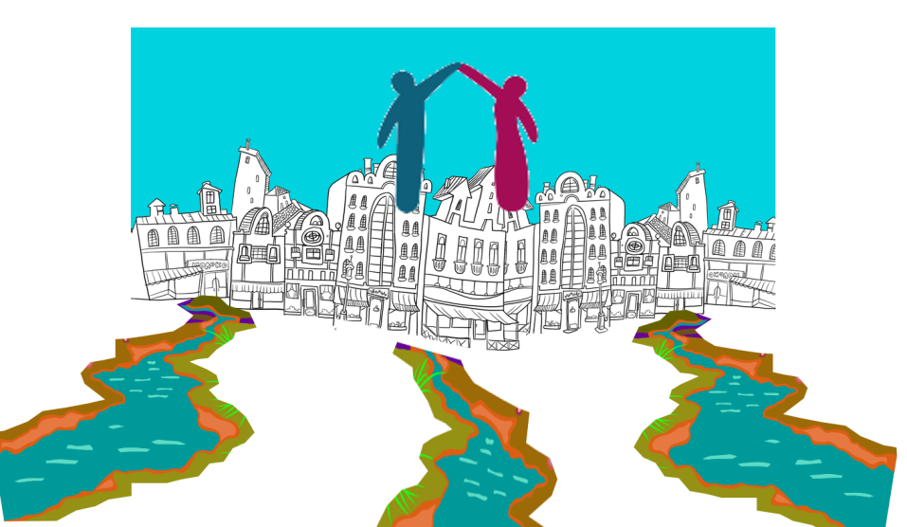
City of Sanctuary Streams
Faith
Welcome
Arts
Health
Schools
Notes:
Rose

Slide 15
The maternity stream: Why and Who?
Leeds- developed stream:
The Refugee ‘s Council Health Befriending Network
Trusting relationship, issues uncovered
6 women suicidal, over 50% domestic abuse
12% maternal deaths to AS&R only 0.3% population (Lewis 2007)
Experiences of women shared at peer support meeting
“I don’t want other women to suffer as I have suffered”
Women need a voice
Maternity Stream – a forum for change, led by women, working in partnership with health professional, researchers and third sector

Slide 16
The work of the volunteers: Leeds
Training in public speaking
Created 2 Maternity Stream of Sanctuary films
Monthly peer support meetings
National and International nursing and midwifery conferences
Chairing conferences
Service users within a university
Talking in parliament
Maternity Services Liaison Committee
Awareness raising sessions for women, student midwives, social workers, medics & university staff
Consultation group for COST European research into birth
Experts guest for COST in Europe
Notes:
Emily

Slide 17
Swansea City of Sanctuary: Where are at the moment?
The ‘Welcome to Swansea’ mentors work with newly arrived asylum seekers and asylum seekers that are isolated- the Health Access team, BASWO and the ACC refer people to us.
Some of those mentored have been pregnant or new mothers, people have given very positive testimony about the care given.
Nationally we know that this is not always the case and there are external factors created by the asylum process which means that this is not always the case.
The stream and a working group would enable us to work strategically together to assist and provide a space for advocacy support for those with issues.
Working together means that we can support those that need it effectively and can work to ensure that people have access to the support and guidance that people need.

Slide 18
Other Working Groups
The BMEC Family and play working group:
Workshops and events
Child protection through a cultural lens
Training for front line staff
Planning future work and events in partnership
Mental Health Working Group
Put together a training pack with resources that enable delivery- over 200 people attended training.
Working together to further develop the training pack.
Working together to promote access to MH services and support.

Slide 19
How can the maternity stream help? What are some of the issues?
Aim to work with maternity services and community organisations and groups to ensure that people have access to support and care.
How? Improve access, experiences and outcomes of maternity services for AS&R women.
Mental Health issues. Stress and anxiety – miscarriage and small babies .
Relive the horrors from home including seeing family members killed
Family left behind
Unhealthy diet
FGM
Domestic violence

Slide 20
References
BRISCOE, L. & LAVENDER, T. 2009. Exploring maternity care for asylum seekers and refugees. British Journal of Midwifery, 17, 17-23.
CMACE 2011. Saving Mothers' Lives: reviewing maternal deaths to make motherhood safer: 2006–08. The Eighth Report on Confidential Enquiries into Maternal Deaths in the United Kingdom. London: CMACE.
Department of Health (2008) Real Involvement: Working with People to Improve Health Services. HMSO, London.
DH (2010) Volunteering- involving people and communities in delivering and developing health and social care services. HMSO, Leeds.
DH (2012) Liberating the NHS: No decision about me, without me- Government response to the consultation. HMSO, London.
SHORTALL C et al (2015) Experiences of Pregnant Migrant Women receiving Ante/Peri and Postnatal care in the UK. A Doctors of the World Report on the Experiences of Attendees at their London Drop in Clinic.
GAUDION, A. & ALLOTEY, P. 2008. Maternity Care for Asylum Seekers and Refugees in Hillingdon. A Needs Assessment. Uxbridge: Centre for Public Health Research, Brunel University.
HAITH-COOPER, M. & BRADSHAW, G. 2013a. Meeting the health and social care needs of pregnant asylum seekers; midwifery students' perspectives: Part 3; “The pregnant woman within the global context”; an inclusive model for midwifery education to address the needs of asylum seeking women in the UK Nurse Education Today, 33, 1045-1050.
NATIONAL INSTITUTE FOR HEALTH AND CLINICAL EXCELLENCE 2010. Antenatal care. Routine care for the healthy pregnant woman. London: National Institute for Health and Clinical Excellence.
WAUGH, M. 2010. The Mothers in Exile Project. Women Asylum Seekers' and Refugees' Experiences of Pregnancy and Childbirth in Leeds. Women’s Health Matters.

